Slide 1
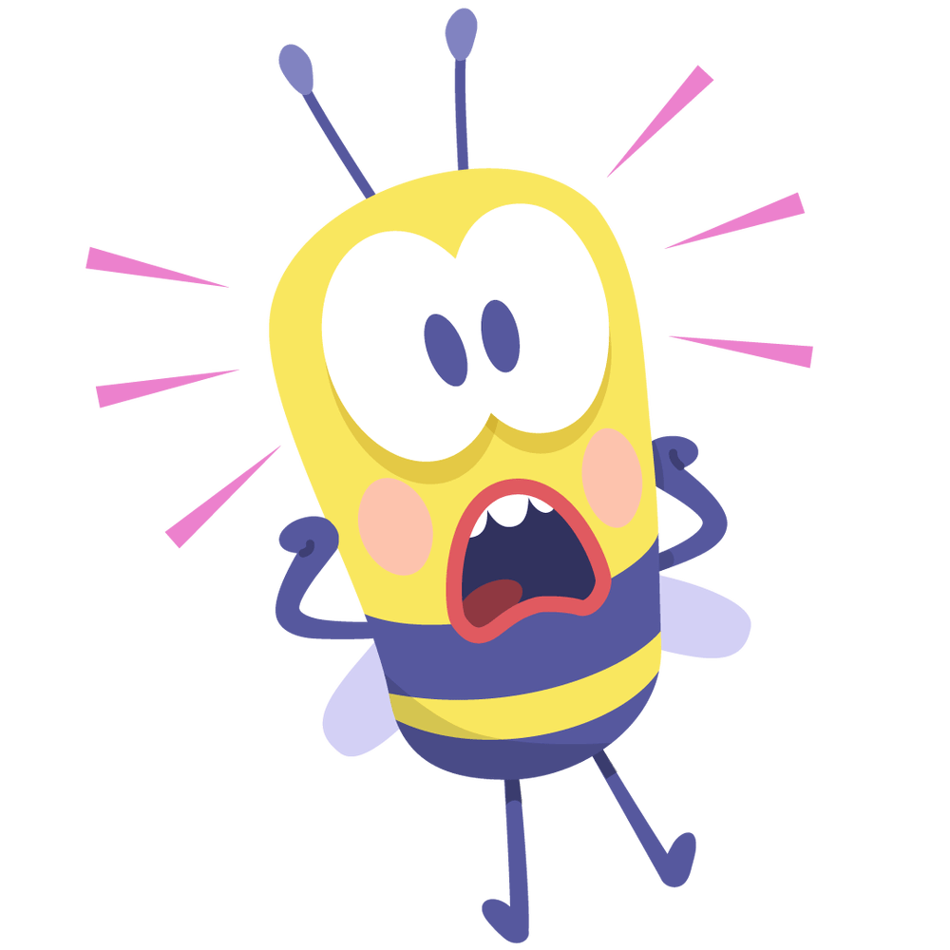
LET’S CHAT TUTORIAL SERIES
STRESS (Level 3 Post-16 learners)

Slide 2
Slide title | Time Guidance | Learner activity | Teacher guidance | Challenge
How are you today? Side 4 | 5 min | Blob tree – Learners to identify which blob they are and put number in chat. Learners can choose to explain their reasoning Hands up activity to establish whether learners experience stress and whether this has been made worse by the pandemic. | Encourage cameras, if not verbal contribution is praised. Encourage open dialogue where possible about how learners feel and stress levels | Reflecting on impact of pandemic on not just themselves but global impact on stress: self employed home schooling loved ones safety and well being economy
What is stress? Slides 5 and 6 | 5 min | Learners define what stress is and the purpose on a MS Form, they also must consider how effectively young people management stress. Teacher to go through stress definition and the stress curve. | Create Microsoft Form | Detailed justifications of how they are at managing stress and the pressures your people go through.
What does stress do on the body? Slide 7 | 2 min | Teacher explains impact of stress physically
What makes you stressed Slide 8 | 5 min | Learners list 5 things that make them stressed on Mentimeter | Create Mentimeter Show Mentimeter live so learners can see the answers | Learners can compare stressors of their peers as reflect that others may experience similar things. There may be other causes of stress that they did not know their peers were experiencing.
What makes us stressed? Slide 9 and 10 | 4 min | Teacher explains slide exploring stressors on young people. Teacher to facilitate discussion and comparison of the results to the Mentifmeter. Teacher then moves on to slide 10 explaining the study. |  | Explore which has the biggest impact on young people’s stress? Evaluation of study (country of origin, year, number of participants)
How do we know we are stressed? Slide 11 | 6 min | Learners note on Jamboard signs and symptoms of stress | Create a Jamboard (could ask learners to put notes in chat if not comfortable with Jamboard. | Identification of different catagories that stress signs can be found in.
How do we know we are stressed? Slide 12 | 2 min | Exploration of stress signs and symptoms |  | Evaluation of likihood and individual differences of stress and how it presents.
Ways to deal with stress Slide 13 and 14 | 8 min | Examine each picture considering what it represents. Learners must then consider themselves and how they can use these strategies and make individual notes Teacher goes through breathing importance and apps |  | Reflecting on the potential impact
Bullet journals Slide 15 | 5 min | Watch video |  | Reflecting on whether this would work for them and justifying answer, Must also create plan of next steps (further research, buy book, plan pages)
Making a change Slide 16 | 4 min | Teacher explains stages of change Learners reflect on what change they could make and write down a new action which they will take. | This work will assess learning within session. Could ask learners to message you their action /change stages, and this could be used in tutorial.
Tutor
Notes
This session is planned to be utilised with your learners as you wish, you may add, change or omit activities or resources.
Some activities may involve preparation before the session, such as setting up a Microsoft Form or a Mentimeter however there will be minimum preparation time.

Slide 3
This Session
Expectations
Respect and confidentiality
Contribution
Learning objectives
Identifying what stress is and how it can benefit us
Establishing when stress may be beneficial and when it may be too much and what stress can do to the body
Reflect on what makes you, other young people and your peers stressed
Consider how do we know when we or others are stressed
Examine strategies to support stress
Reflect on how we can make a change and explore the change curve
You will be challenged in this session to justify your answers, to challenge your thinking, to reflect, be honest and to evaluate.

Slide 4
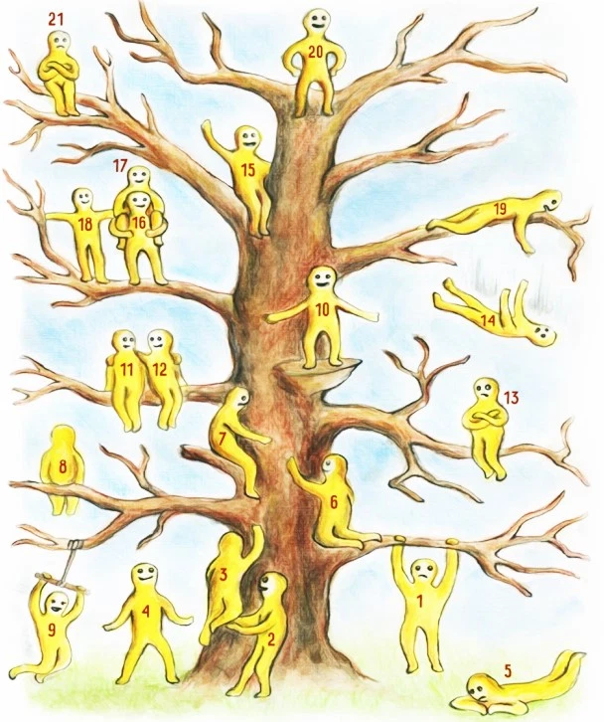
How are you today?
How are you today?
Which blob person represents how you feel today?
Pop your number in the chat
If you feel comfortable please could you either share in the chat or verbally why you have chosen this number.
Next
Hands up if you have felt stressed at least once in the last week?
Now pop your hands down
Hands up if you think your stress has been made worse by the pandemic?

Slide 5
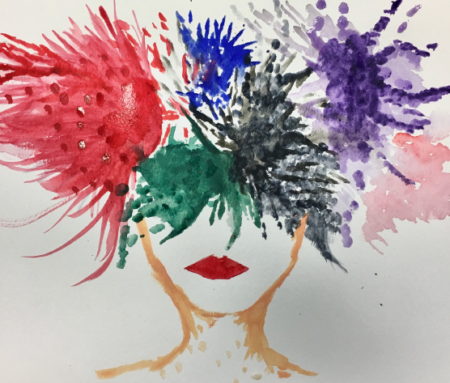
What is Stress?
On a Microsoft Form answer:
What is stress?
Why do we get stressed? Consider the impact on the body.
How effective are you at managing stress (provide justified statements)

Slide 6
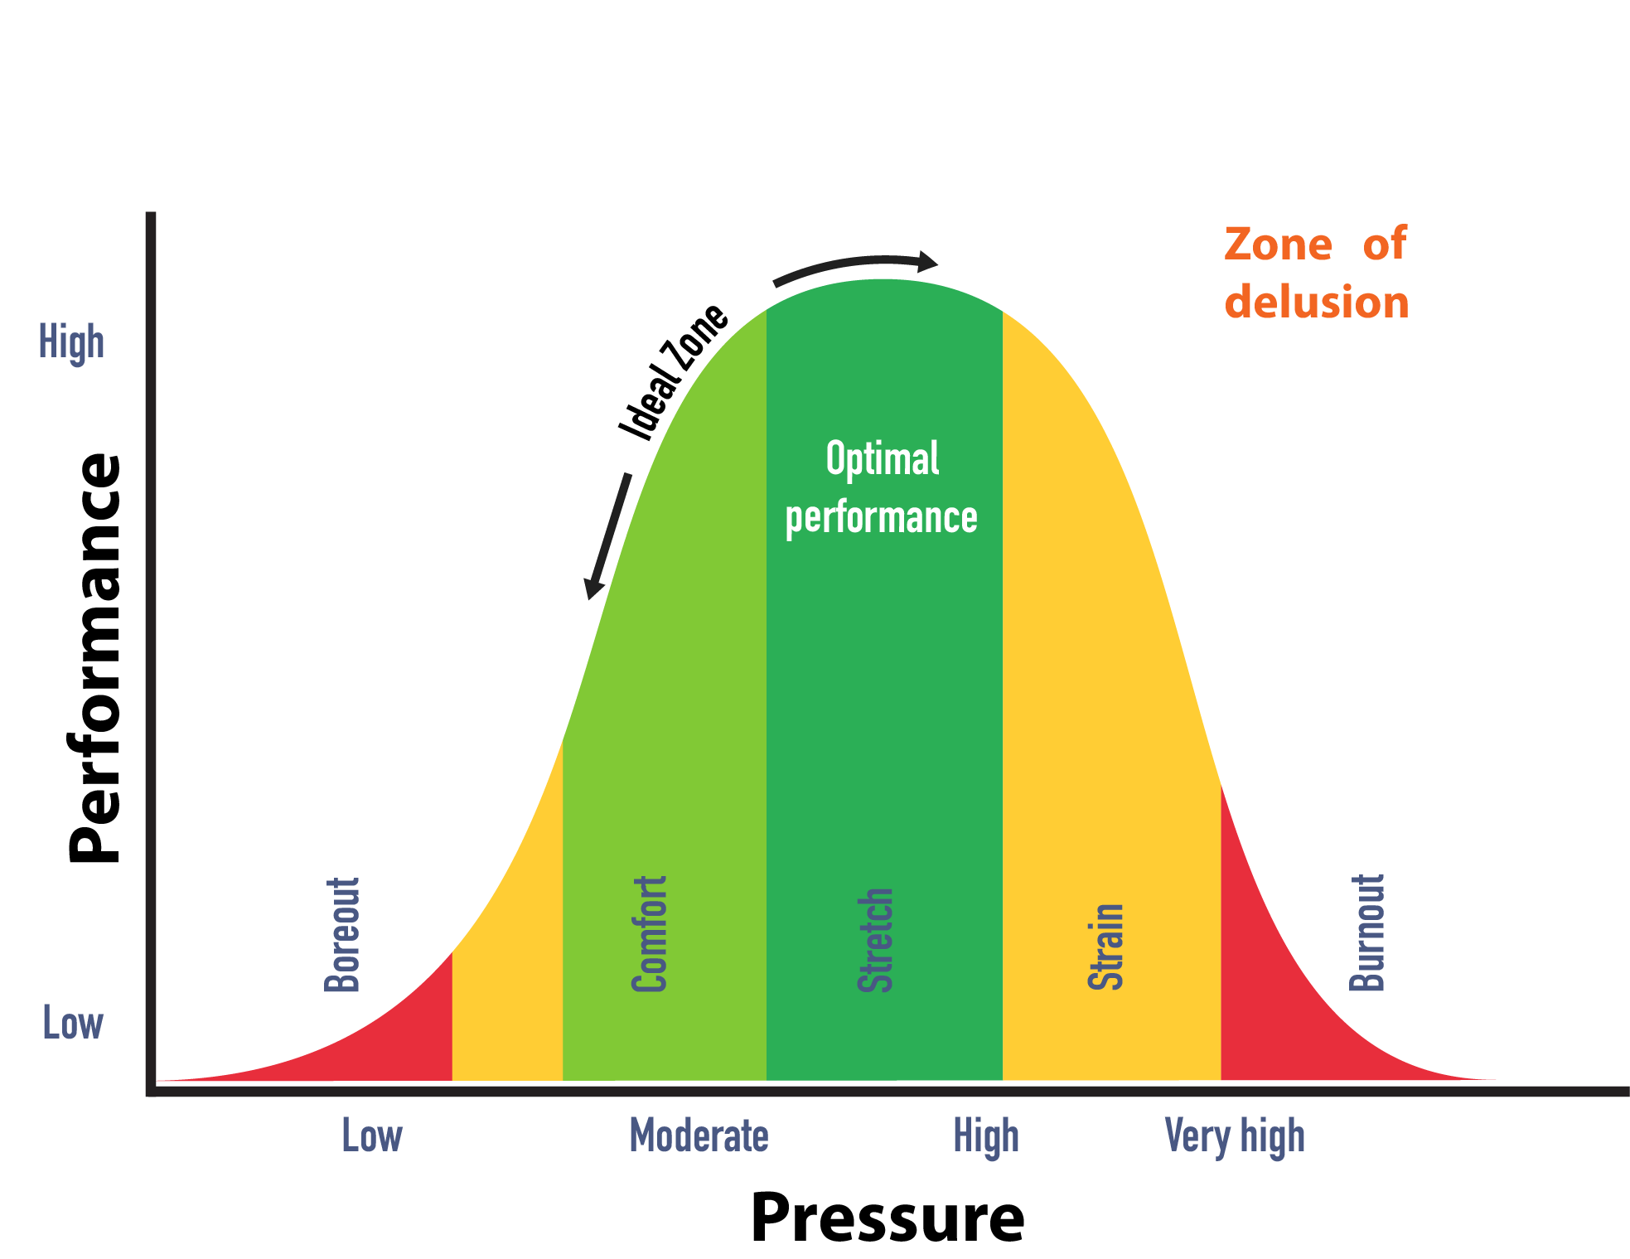
What is stress?
What is stress?
Stress is the body's reaction to feeling threatened or under pressure.
Fight, flight or freeze
It can help achieve our goals or to get jobs done
Too much stress can affect our mood, our body and our relationships
It can make us feel anxious and irritable, and affect our self-esteem.
Stress over a long period of time can also lead to a feeling of physical, mental and emotional exhaustion
Too much stress can also have a negative impact on our bodies
NHS 2021

Slide 7
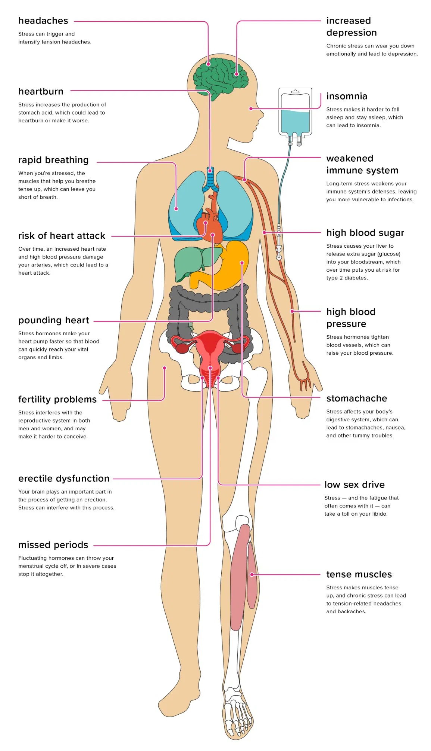
What does stress do to the body
Optional: To watch a video detailing more specific stress processes on the body – watch this

Slide 8
What makes you stressed?
Make a list of the things that make you stressed
On the Mentimeter put 5 of the things that make you most stressed (no one will be able to see which response is yours)

Slide 9
What makes us stressed?
What does our Mentimeter say, are there any additional stressors which are not on this list? Which do you think has the biggest impact on young people and their stress?

Slide 10
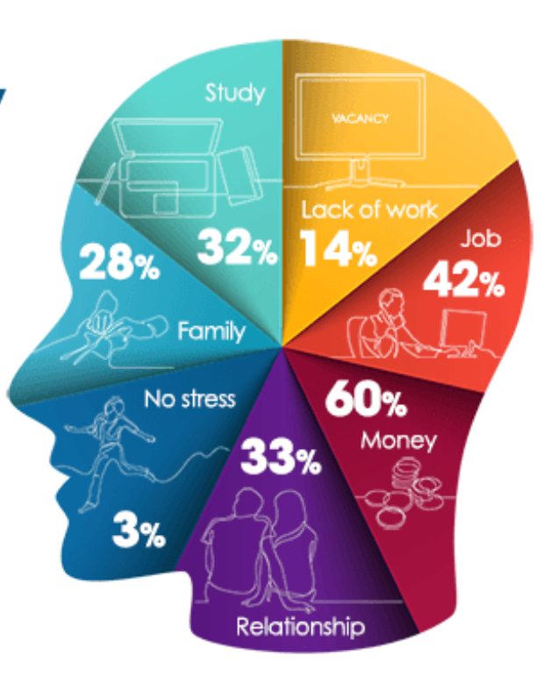
A poll commissioned in 2017 by youth charity The Mix found that the majority of young people (97%) feel stressed, with 45% thinking about their sources of stress multiple times a day.
75% of young people use one or more of the following to cope with stress and see it as an issue – drink, drugs, sex, shopping, social media, eating and exercise.
The survey revealed that not having enough money was the largest source of young people’s stress (60%) followed by work (42%) and studies (32%). The research was conducted by OnePulse and surveyed 1,292 respondents aged 16-25 years-old.
How could you analyse this piece of research?

Slide 11
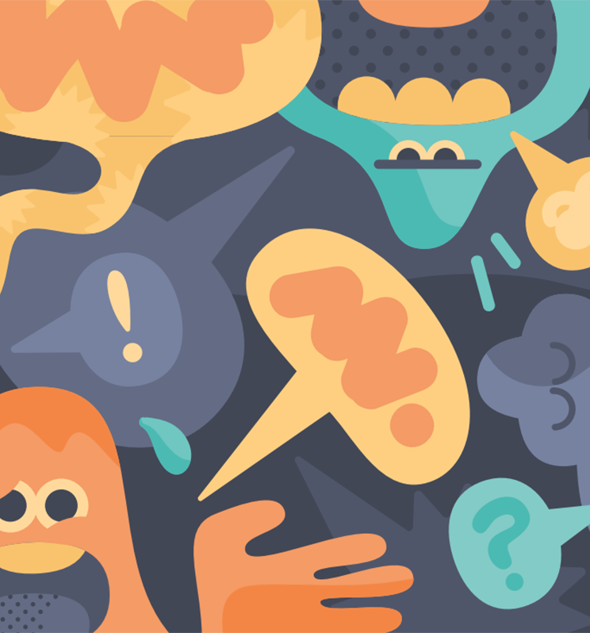
How do we know we are stressed?
Use the link to a Jamboard, on the digital post it notes write signs that we are stressed.
Note:
Put your name on each post it
Consider whether there could be different categories of signs that we are stressed, what could these be? Pop these ideas on a blue coloured post it on the Jamboard.

Slide 12
How do we know we are stressed?
Cognitive Symptoms
Memory problems
Poor Concentration
Poor Judgement
Negative thoughts
Anxiety
Worry
Nervousness
Emotional Symptoms
Moodiness
Irritable/Temper
Agitation
Feeling overwhelmed
Loneliness
Isolation
Unhappiness
Physical Symptoms
Muscle Tension
Aches
Stomach problems
Nausea
Dizziness
Chest pain
Racing heart
Colds and allergies
Behavioural Symptoms Appetite changes Sleep changes Social withdrawal Procrastination Avoiding responsibility Substance abuse Nervous habits
How likely do you think these symptoms are?
Evaluate the individual differences that may be experienced and observed by individuals

Slide 13
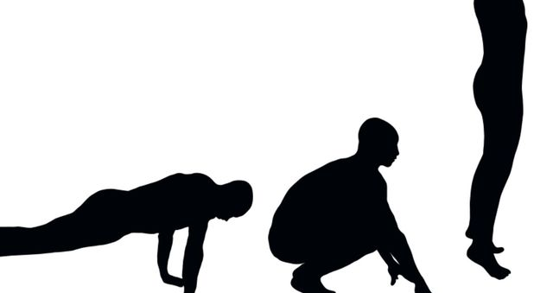
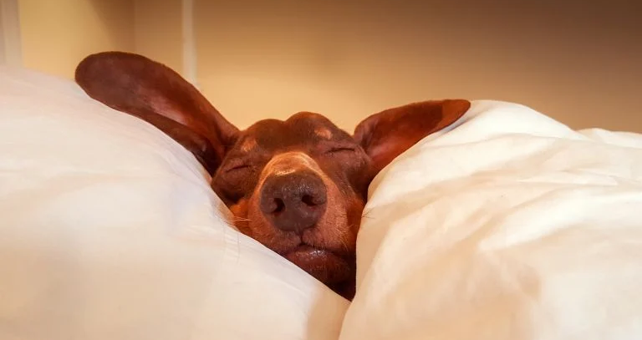
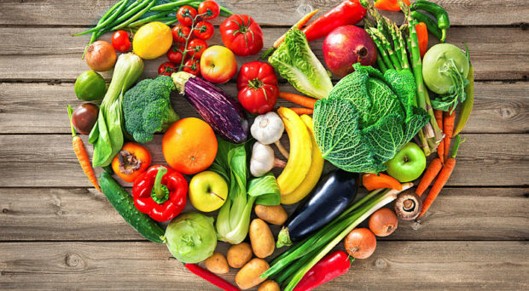
Ways to deal with stress
Exercise Sleep and rest Talking to someone
Doing things that make you happy Focusing on your strengths Healthy eating/regular meals
Task (4 min)
Write down:
What can you do which you enjoy
Your strengths
Your day routine
What does each picture represent?
What healthy things do you like to do which make you happy?

Slide 14
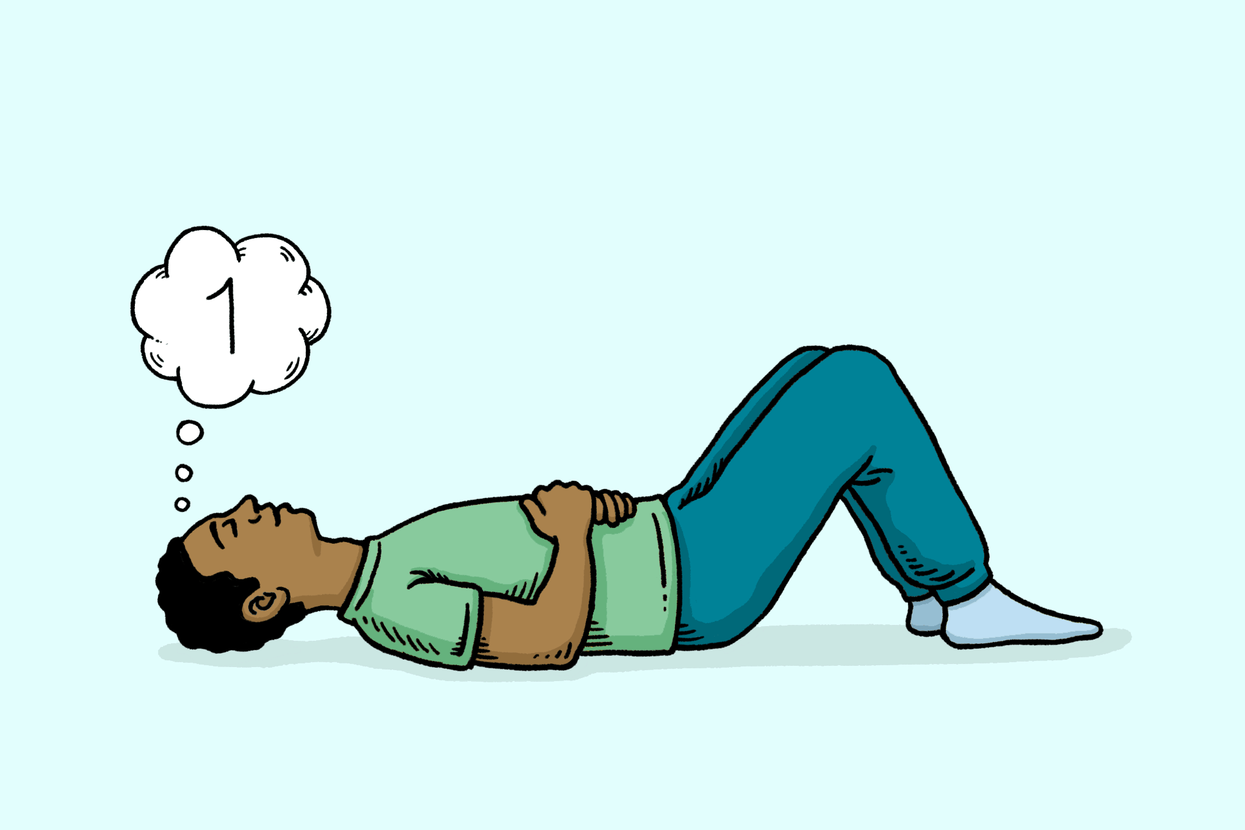
Top apps to deal with stress
Top apps to deal with stress
Remember what the video said – remember to breathe
Calm: guided meditations and sleep stories to ease stress and improve sleep
Headspace: train your mind for a healthier, happier life by reducing daily anxieties and stresses
Breathe2Relax: portable stress management tool

Slide 15
Bullet Journals
Organising also helps stress levels – here is a strategy which may work for you
Would this work for you?
If no why not? (justify your answer)
If yes – what are your next steps to bullet journaling?
Find out more here

Slide 16
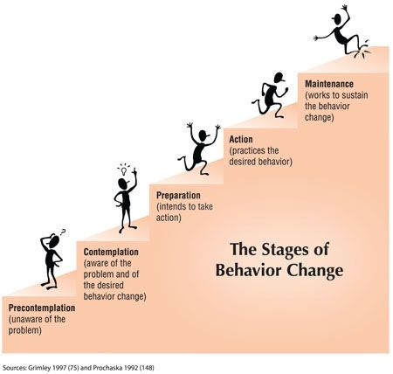
Making a change
What will your change be? How are you going to manage your stress?
On the right is the 5 steps of change
Document an example of how you may fit into these stages, and what action are you going to take using todays session.
You can message me your behaviour change via Team message and we can discuss in tutorial

Slide 17
Extra Resources
PDF worksheet breaking down some of the key strategies discussed to enable personalisation - here
Managing stress in CV 19 - here
Another organisational strategy, the Kanban board – link
25 minute video by Let’s Chat a qualified therapist exploring what stress is and how we manage it - link
Tips on organisation from the NHS - link
A link to video of a 17 year old discussing her anxiety triggered by exam pressure, she also explores strategies which have helped her - link

Slide 18
THANK YOU
For further information on this topic including a webinar led by specialist wellbeing practitioners, please visit the Talking Health series on the Let’s Chat website.
Let’s Chat Talking Health webinar series

