Slide 1
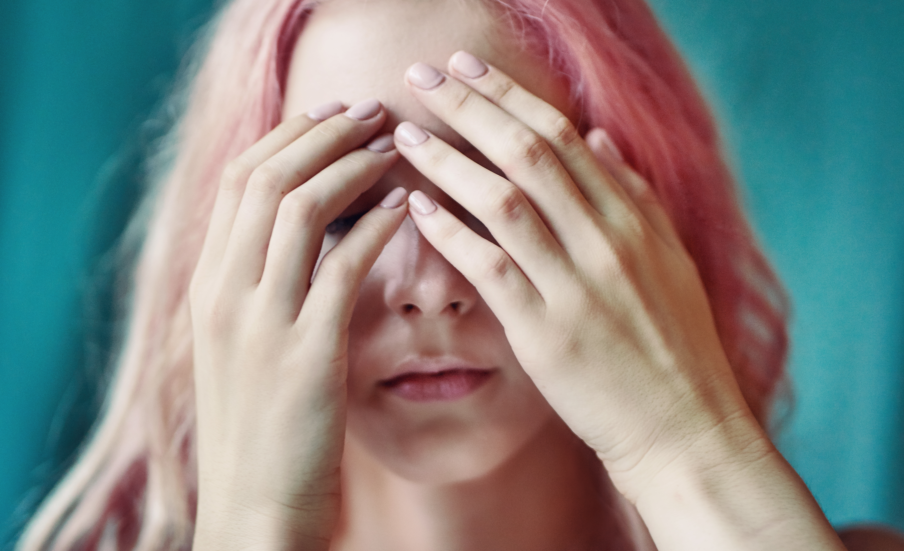
LET’S CHAT TUTORIAL SERIES
STRESS (Level 1 Post-16 learners)

Slide 2
Tutor Notes
Slide title | Time | Learner activity | Teacher guidance
How are you today? Side 4 | 5 min | Blob tree – Learners to identify which blob they are and put number in chat. Learners can choose to explain their reasoning Hands up activity to establish whether learners experience stress and whether this has been made worse by the pandemic. | Encourage cameras, if not verbal contribution is praised. Encourage open dialogue where possible about how learners feel and stress levels
What is stress? Slides 5 and 6 | 5 min | Learners define what stress is and the purpose on a MS Form, they also must consider how effectively young people management stress. Teacher to go through stress definition and the stress curve. | Create Microsoft Form
A little more about stress Slide 7 | 4 min | Video Learners asked to reflect on what stress is.
What makes you stressed Slide 8 | 5 min | Learners list 5 things that make them stressed on Mentimeter | Create Mentimeter Show Mentimeter live so learners can see the answers
What makes us stressed? Slide 9 | 4 min | Teacher explains slide exploring stressors on young people. Teacher to facilitate discussion and comparison of the results to the Mentifmeter. | Ask learners to reflect on similarities and may also allow learners to understand that others experience more than we know
How do we know we are stressed? Slide 10 | 6 min | Learners note on Jamboard signs and symptoms of stress | Create a Jamboard (could ask learners to put notes in chat if not comfortable with Jamboard.
How do we know we are stressed? Slide 11 | 2 min | Exploration of stress signs and symptoms
Ways to deal with stress Slide 12 and 13 | 8 min | Examine each picture considering what it represents. Learners must then consider themselves and how they can use these strategies and make individual notes. Teacher sign posts apps and breathing exercises. | Facilitate discussion of things learners can do which they may enjoy: Working on a car Reading Going for a walk Cooking Art
Screen time Slide 14 | 3 min | Ask learners to reflect on the impact of social media, TV, films, Teams, on their stress and how they can support themselves with this including screen free time before bed.
Stress swaps -Slide 15, 16 | 5 min | Cartoons supporting learners in lessening stress and being proactive
Making a change Slide 18 | 4 min | Teacher learners reflect on what changes they could make and write them down in the brain worsksheet. | This work will assess learning within session. Could ask learners to send this to you or add as an assignment to Teams, this could be used in tutorial.
This session is planned to be utilised with your learners as you wish, you may add, change or omit activities or resources.
Some activities may involve preparation before the session, such as setting up a Microsoft Form or a Mentimeter however there will be minimum preparation time.

Slide 3
This Session
Expectations
Respect and confidentiality
Contribution
What we will learn today:
We will look at what stress is and how it effects our bodies
We will examine what makes us stressed
We will also examine signs that we are stressed
Importantly we are going to look at ways we can manage our stress
We will develop a plan of change.

Slide 4
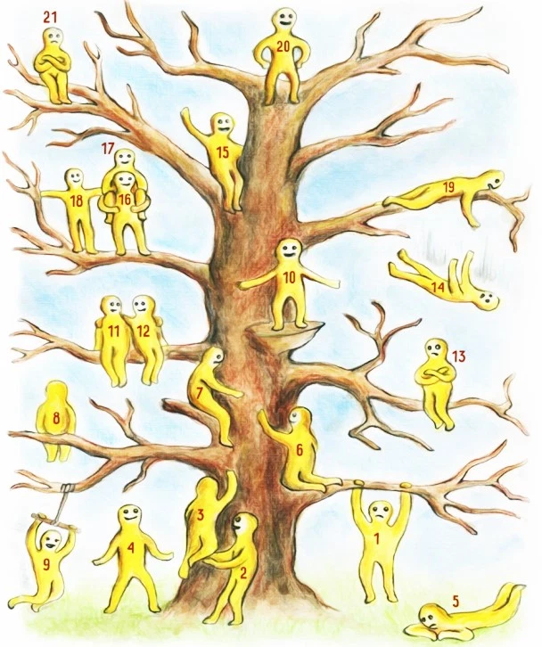
How are you today?
How are you today?
Which blob person represents how you feel today?
Pop your number in the chat
If you feel comfortable please could you either share in the chat or verbally why you have chosen this number.
Next
Hands up if you have felt stressed at least once in the last week?
Now pop your hands down
Hands up if you think your stress has been made worse by the pandemic?

Slide 5
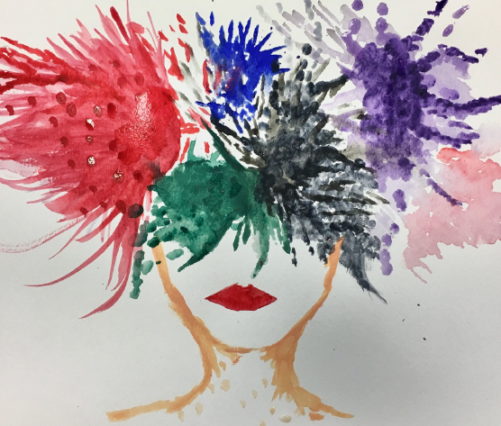
What is Stress?
On a Microsoft Form answer:
What is stress?
What does stress do to us?

Slide 6
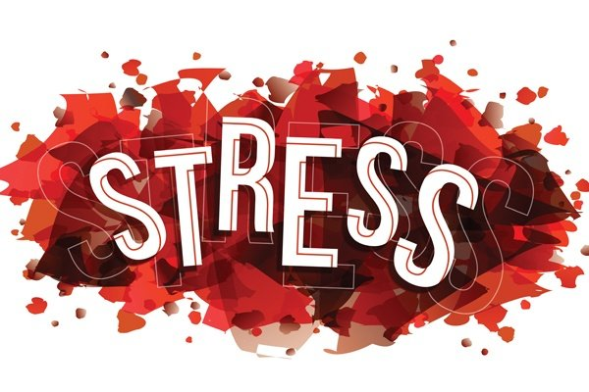
What is stress?
Stress is the body's reaction to feeling threatened or under pressure.
Fight, flight or freeze
It can help achieve our goals or to get jobs done
Too much stress can affect our mood, our body and our relationships
It can make us feel anxious and irritable, and affect our self-esteem.
Stress over a long period of time can also lead to a feeling of physical, mental and emotional exhaustion
Too much stress can also have a negative impact on our bodies
NHS 2021

Slide 7
A little more about stress

Slide 8
What makes you stressed?
Make a list of the things that make you stressed
On the Mentimeter put 3 of the things that make you most stressed (no one will be able to see which response is yours)

Slide 9
What makes us stressed?
What does our Mentimeter say, are there any additional stressors which are not on this list? Which do you think has the biggest impact on young people and their stress?

Slide 10
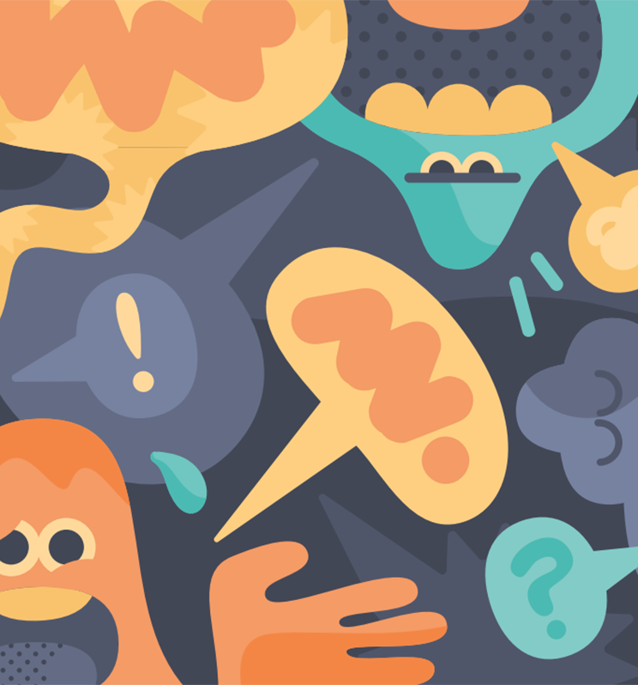
How do we know we are stressed?
Use the link to a Jamboard, on the digital post it notes write signs that we are stressed.
Note:
Put your name on each post it

Slide 11
How do we know we are stressed?
Cognitive Symptoms
Memory problems
Poor Concentration
Poor Judgement
Negative thoughts
Anxiety
Worry
Nervousness
Emotional Symptoms
Moodiness
Irritable/Temper
Agitation
Feeling overwhelmed
Loneliness
Isolation
Unhappiness
Physical Symptoms
Muscle Tension
Aches
Stomach problems
Nausea
Dizziness
Chest pain
Racing heart
Colds and allergies
Behavioural Symptoms Appetite changes Sleep changes Social withdrawal Procrastination Avoiding responsibility Substance abuse Nervous habits

Slide 12
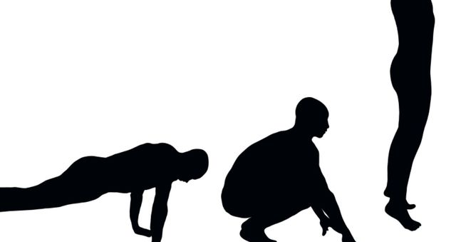
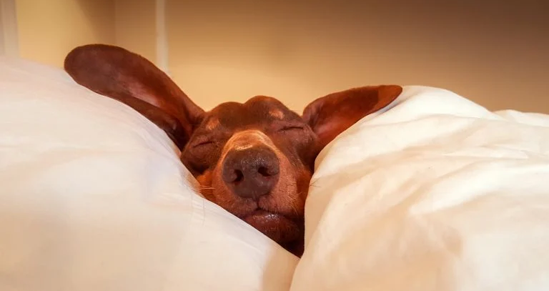
Ways to deal with stress
Exercise Sleep and rest Talking to someone
Doing things that make you happy Focusing on your strengths Healthy eating/regular meals
Task (4 min)
Write down:
What can you do which you enjoy
Your strengths
Your day routine
What does each picture represent?

Slide 13
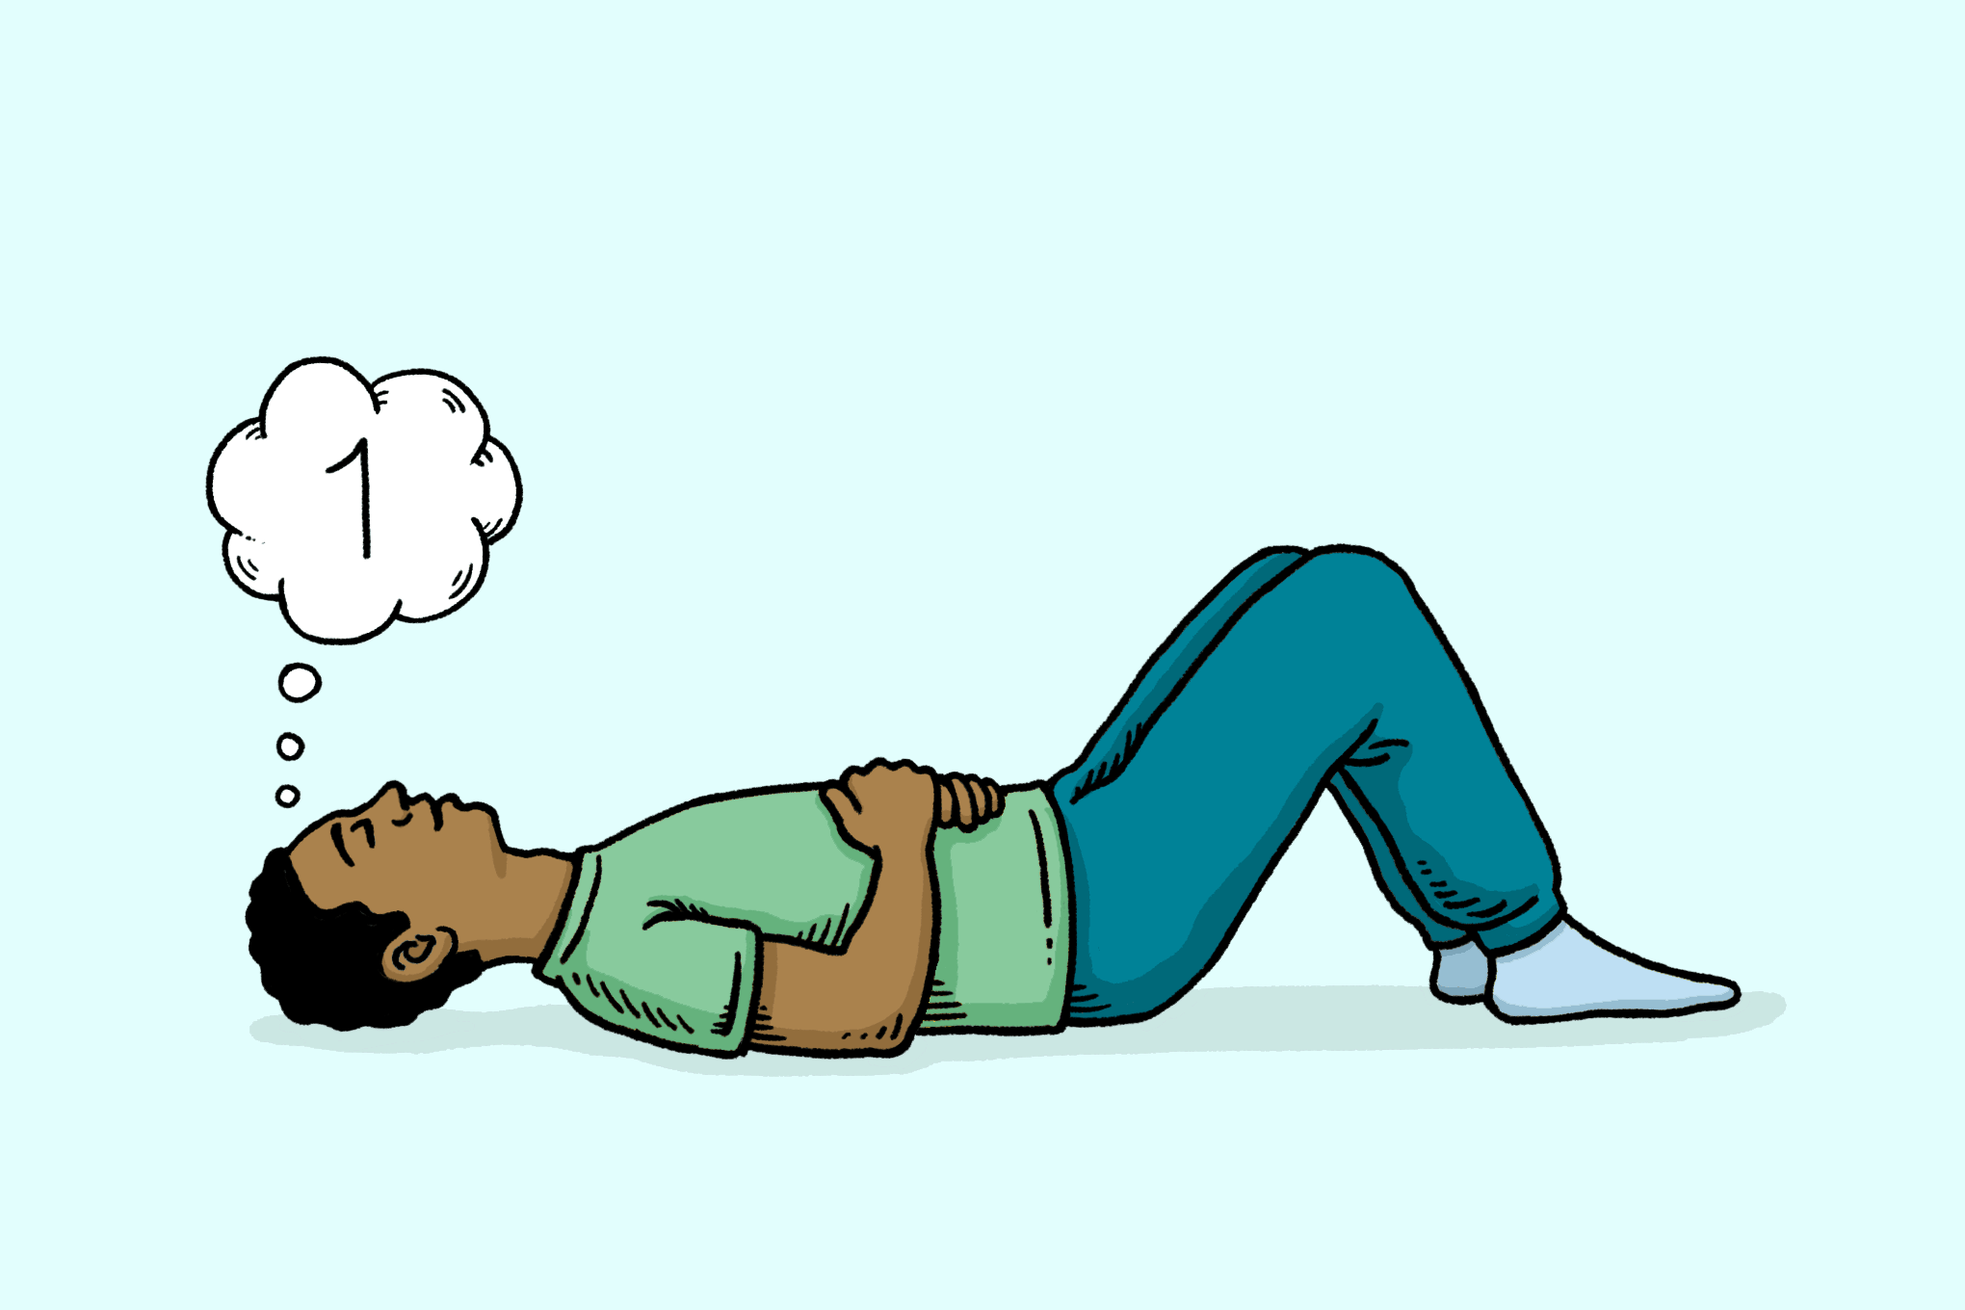
Top apps to deal with stress
Top apps to deal with stress
Remember what the video said – remember to breathe
Calm: guided meditations and sleep stories to ease stress and improve sleep
Headspace: train your mind for a healthier, happier life by reducing daily anxieties and stresses
Breathe2Relax: portable stress management tool

Slide 14
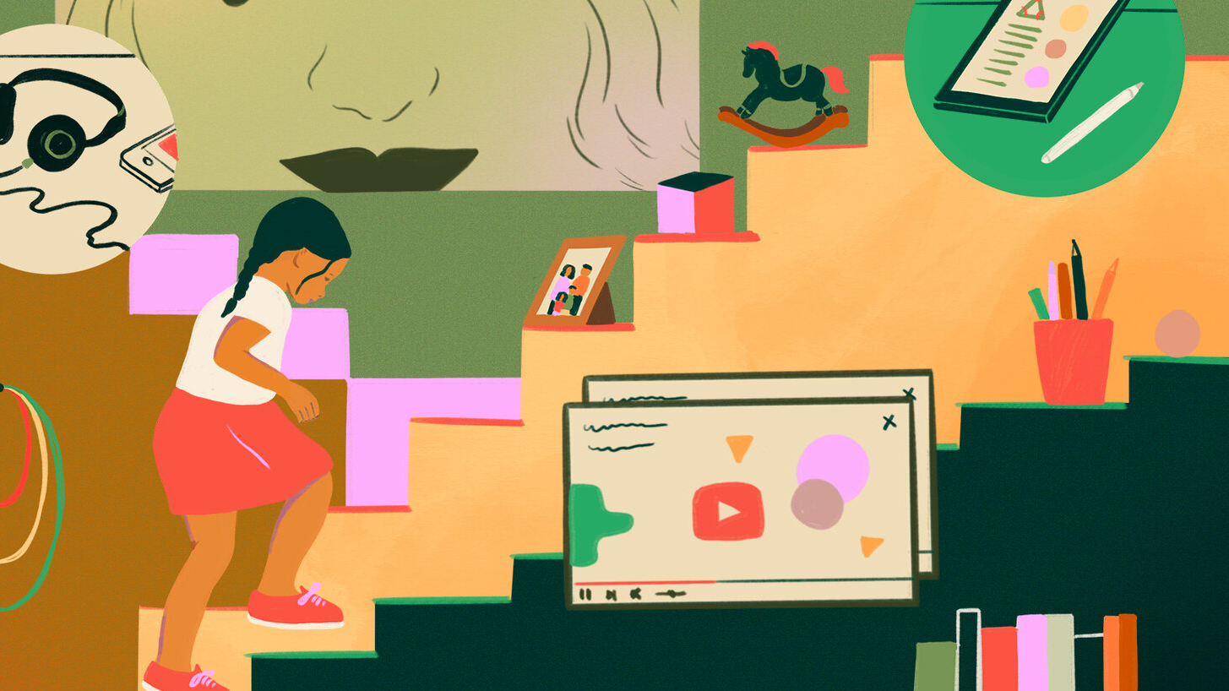
Screen Time
Screen time can be positive such as using the apps, talking to others about how you are feeling, however too much screen time can also make our stress worse.
Why do you think screen time, including social media can have a negative effect on our stress?
What can you do about this?

Slide 15
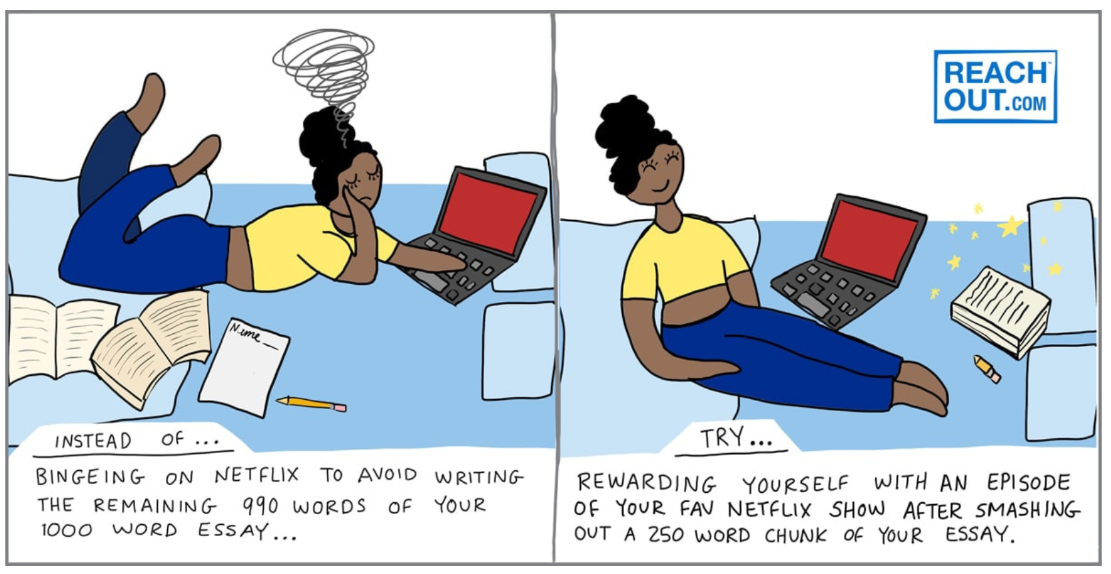
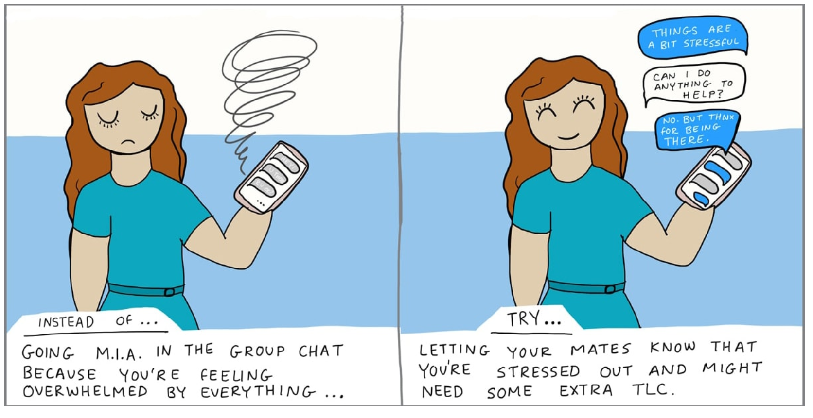
Stress Swaps

Slide 16
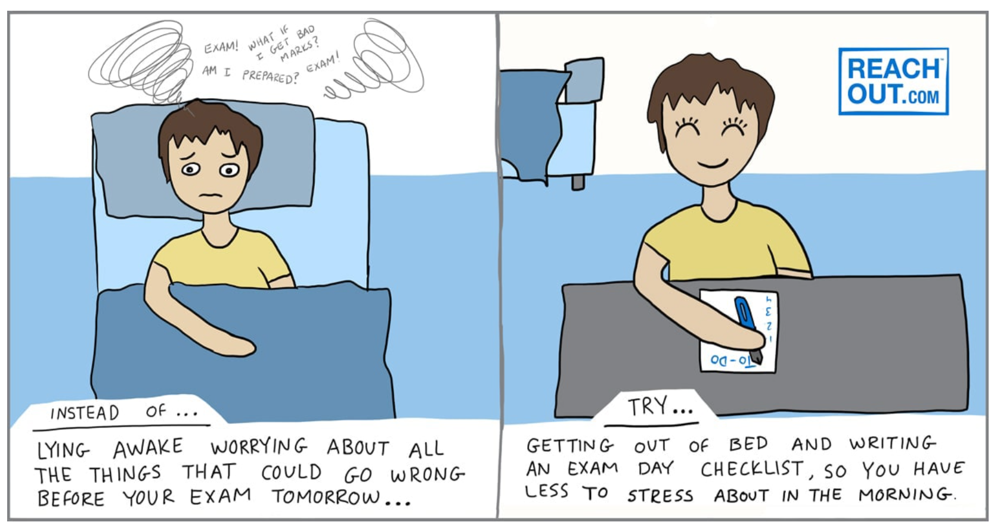
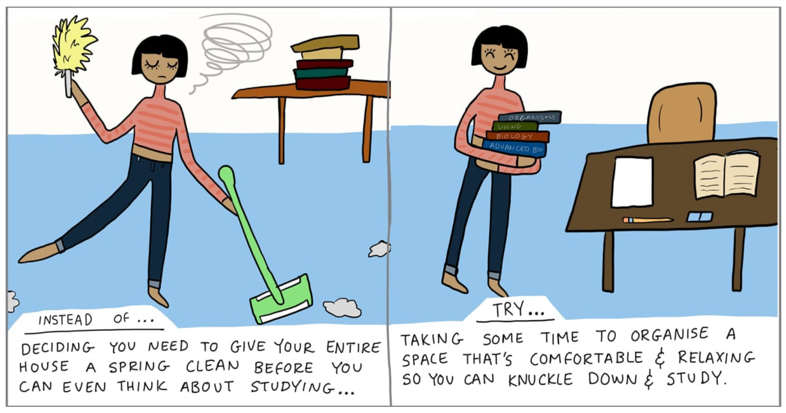
Stress Swaps

Slide 17
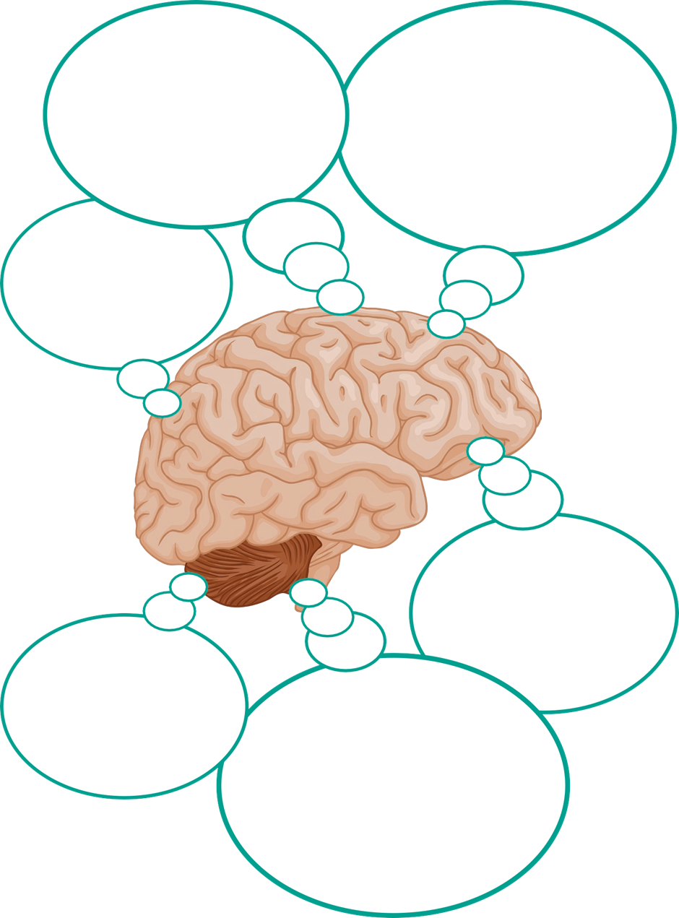
Making a Change
A worksheet will be put into the chat – link here
In each box consider what change you are going to make and how.
Really think about how these changes will help you.

Slide 18
Extra Resources
PDF worksheet breaking down some of the key strategies discussed to enable personalisation - here
Managing stress in CV 19 - here
A link to video of a 17 year old discussing her anxiety triggered by exam pressure, she also explores strategies which have helped her - link
How to Make Aromatherapy Stress Balls - One Essential Community

Slide 19
THANK YOU
For further information on this topic including a webinar led by specialist wellbeing practitioners, please visit the Talking Health series on the Let’s Chat website.
Let’s Chat Talking Health webinar series

