Slide 1
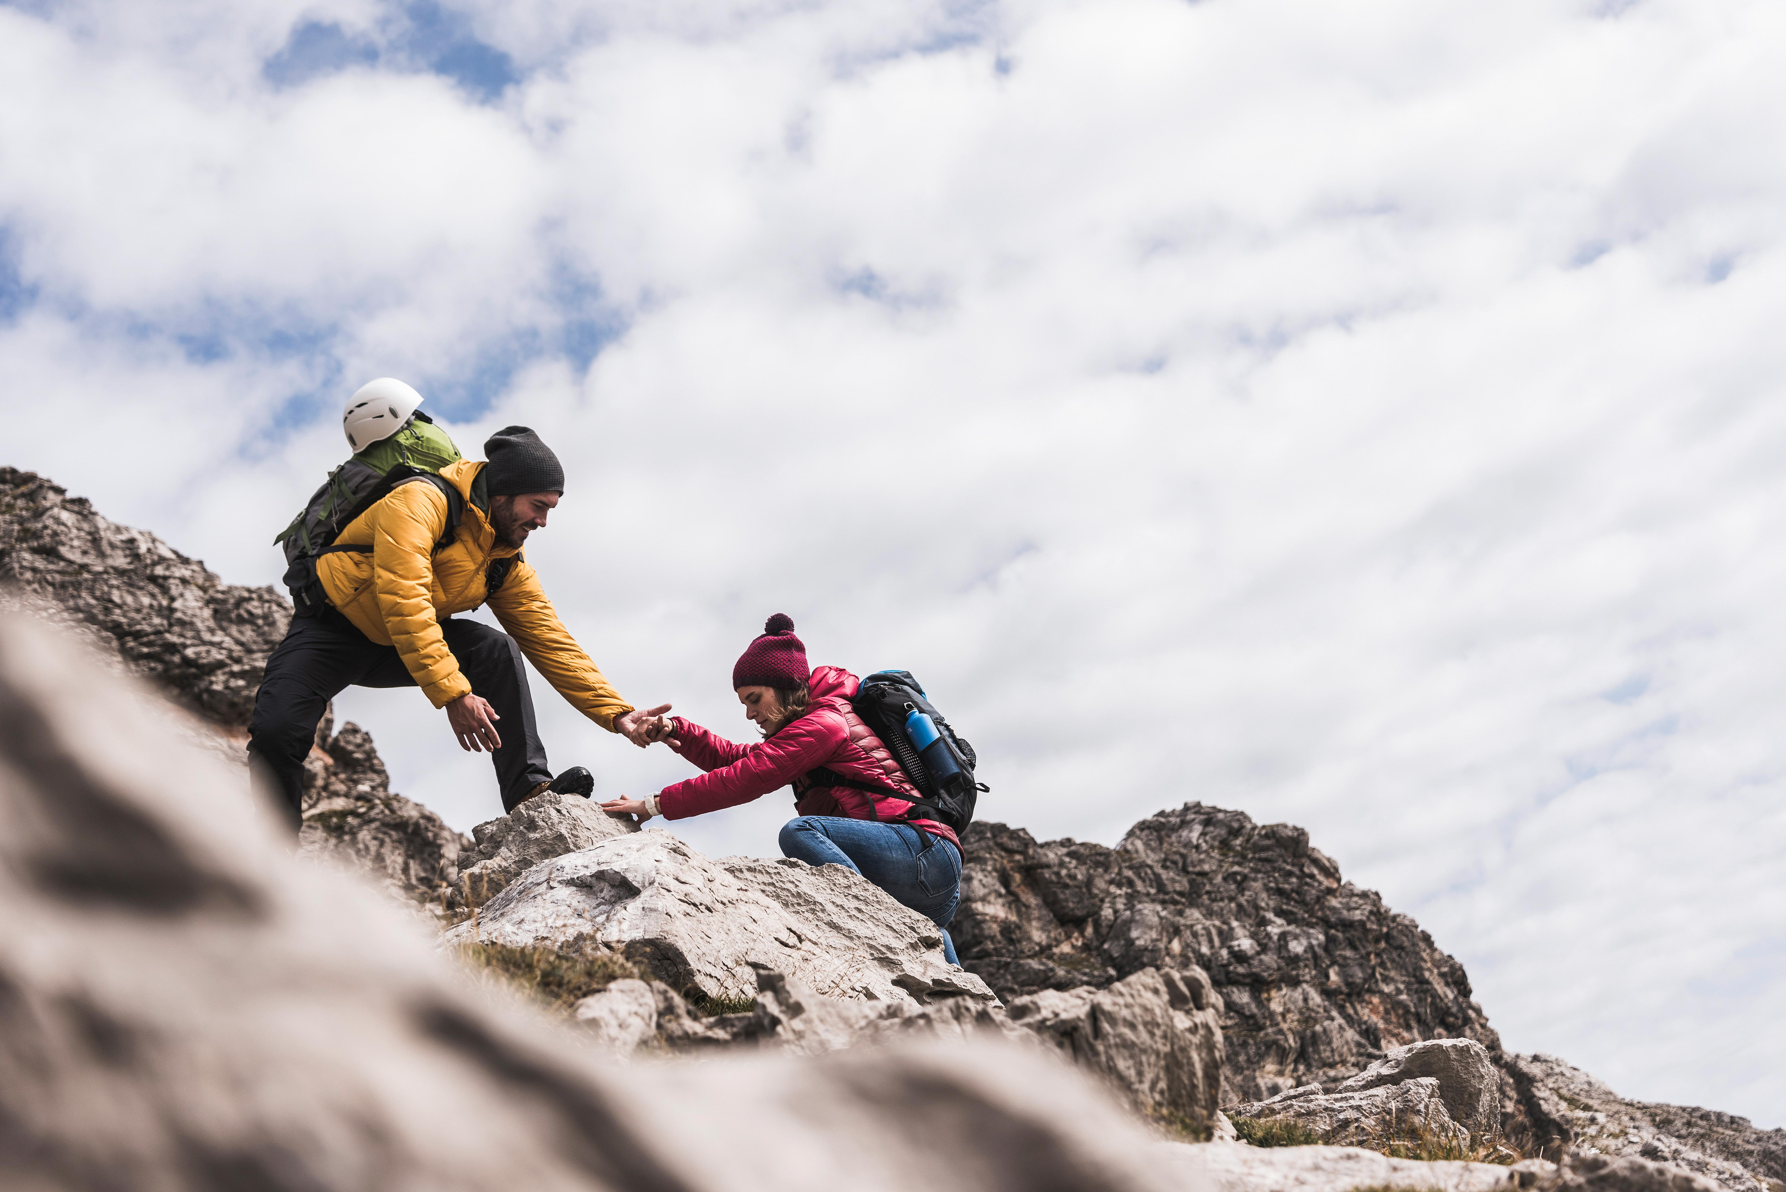
LET’S CHAT TUTORIAL SERIES
“Life is difficult” ​
by Scott Peck, author of ‘The Road less Travelled
RESILIENCE (Level 1 Post-16 learners)

Slide 2
Slide titleS | Time | Learner activity | Teacher guidance
How are you today? Side 4 | 5 min | Hands up activity to establish whether learners experience. Share examples of what has built individual resilience? Has the pandemic played a part in this? | Encourage cameras, if not verbal contribution is praised. Encourage open dialogue where possible about how resilient learners feel and how they have become resilient?
What is Resilience? Slides 5 and 6 | 5 min | Learners define what resilience is and the purpose on a MS Form, they also must consider how effectively young people build resilience? Teacher to go through resilience definition and share ideas? | Create Microsoft Form. Image of TOBY FRENCH FROM BURNHAM ON SEA (LATER FEATURED ON SLIDES 12-13)
A little more about Resilience. Slide 7 | 3 min | Video Learners asked to reflect. Offer opinions.
Resilience definition. Slide 8 | 5 min | Learners list 5 things that make them stressed on Mentimeter | Create Mentimeter Show Mentimeter live so learners can see the answers
What makes you resilient? Slide 9 | 4 min | Teacher explains slide exploring stressors on young people. Teacher to facilitate discussion and comparison of the results to the Mentifmeter. | Ask learners to reflect on similarities and may also allow learners to understand that others experience more than we know.
Slide 10 Share what and how we can build/Develop our resilience? | 6 min | Eencourage learners to share their ideas if they wish from the Mentimeter. | Teacher to encourage learners to contribute and share ideas form Mentimeter.
Real-life inspiration TOBY FRENCH Slide 11 and 12 | 8 Min 10Min | His name is TOBY, he is an Amputee from Birth, a member of BARB search and rescue, 4x tough Mudder and can complete 5k in 30.09 Minutes. WATCH THE CLIP… | Facilitate discussion and share instructions with learners. Facilitate learners into break-out rooms.
Screen time Slide 13 | 3 min | Discussion time. Learners will be encouraged to share ideas raised during the task. | Teacher to facilitate and encourage learners to share experiences or ideas. Some learners will feel happy to unmute and turn cameras on.
Ways to build resilience. Slide 14 | 5 min | Encourage learners to list individual examples of how to develop their resilience.
Wheel of life. Slide 15 | 10 min | ‘Wheel of life’. Learners should identify an area within their life that they could make an action within 24 hours. | Teacher to share the visual of the Wheel of Life.
Resources Slide 16 | 3 -4 mins | Learners can access links which would be of benefit. | Teachers to encourage learners to access and support.
Tutor Notes
This session is planned to be utilised with your learners as you wish, you may add, change or omit activities or resources.
Some activities may involve preparation before the session, such as setting up a Microsoft Form or a Mentimeter however there will be minimum preparation time.

Slide 3
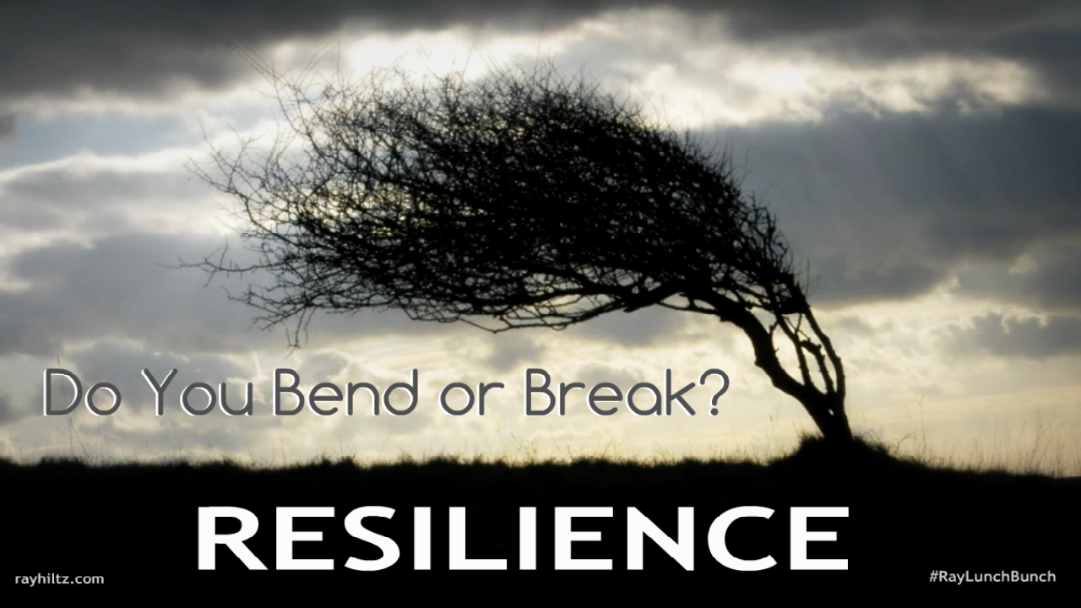
This session
Expectations
Respect and confidentiality
Contribution
What we will learn today:
You will know what the meaning of resilience is.
You will understand what a feeling of resilience might feel like.
We will also examine what makes us resilient.
Consider how we build resilience.
Why is resilience important?

Slide 4
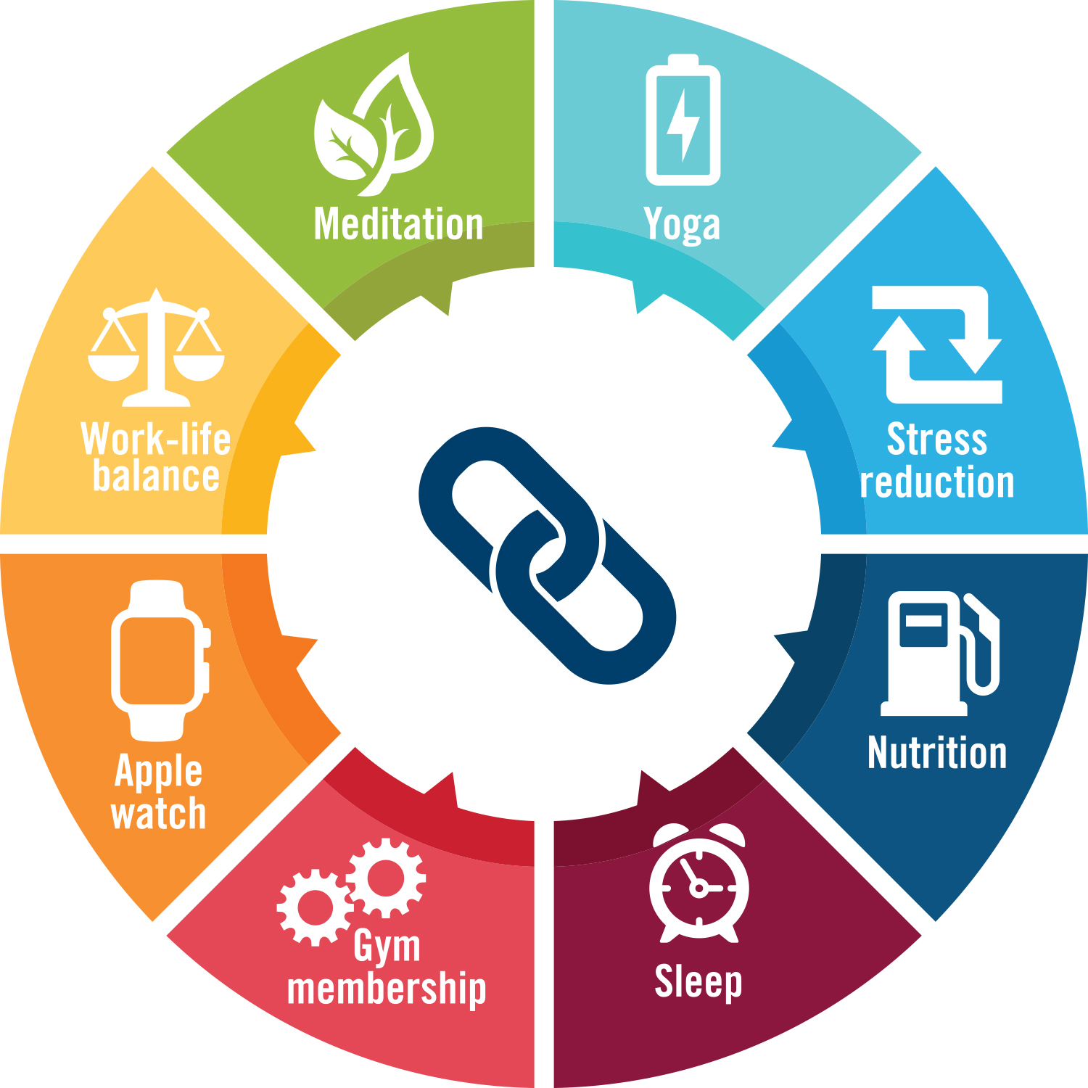
How resilient have you been this week?
Can you share one example in the group chat or un-mute your mics and share your experience?

Slide 5
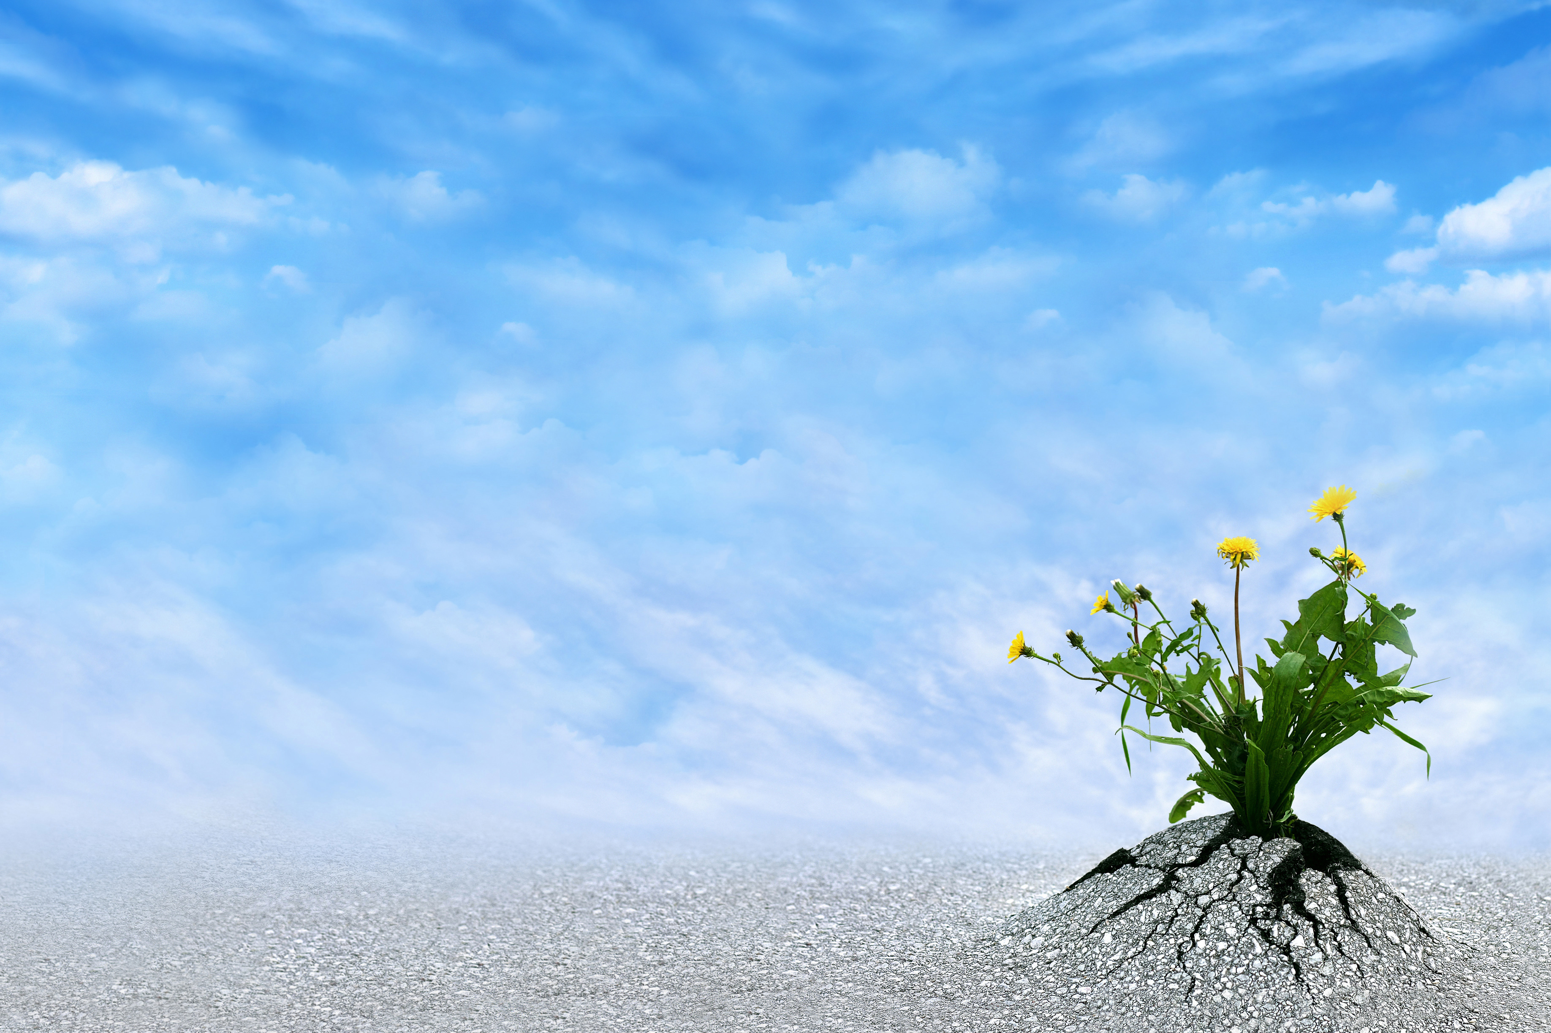
What is Resilience?
On a Microsoft Form answer:
What is Resilience?
What helps somebody become resilient?

Slide 6
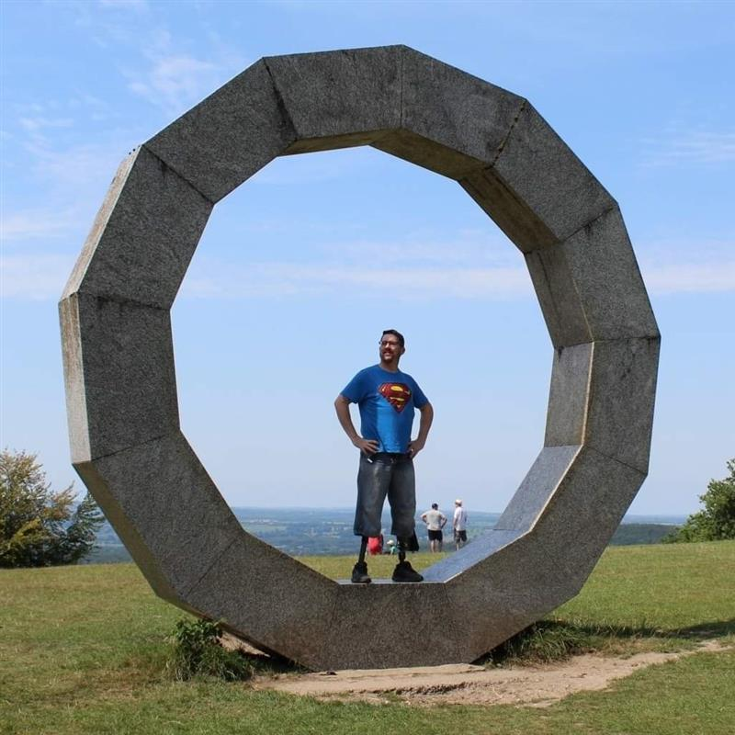
The first aspect of a resilience approach is understanding what makes us vulnerable to stress.
Research has highlighted key factors that can increase our risk of stress and negatively impact our resilience.
https://people.nhs.uk/

Slide 7
A little more about Resilience

Slide 8
DEFINTION
“Resilience is the capacity to recover quickly from difficulties and tough situations.”
Or
Resilience is “the ability of a substance or object to spring back into shape; elasticity.”

Slide 9
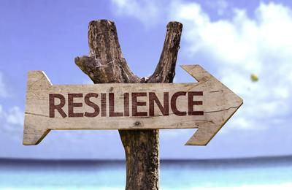
What makes you become more resilient?
Make a list of the things that make you stronger?
On the Mentimeter list 3 examples of what has made you resilient (no one will be able to see which response is yours).

Slide 10
What builds our resilience?
What does our Mentimeter say? What particular issues have built your resilience? Why might this be important for us to survive well and become more successful?
Are there any additional stressors which are not on this list? Can you discuss the causes of what might build the resilience of young people?

Slide 11
REAL-LIFE inspiration.
Meet a friend of a staff member.
His name is TOBY, he is an Amputee from Birth, a member of BARB search and rescue, 4x tough Mudder and can complete 5k in 30.09 Minutes.
WATCH THE CLIP

Slide 12
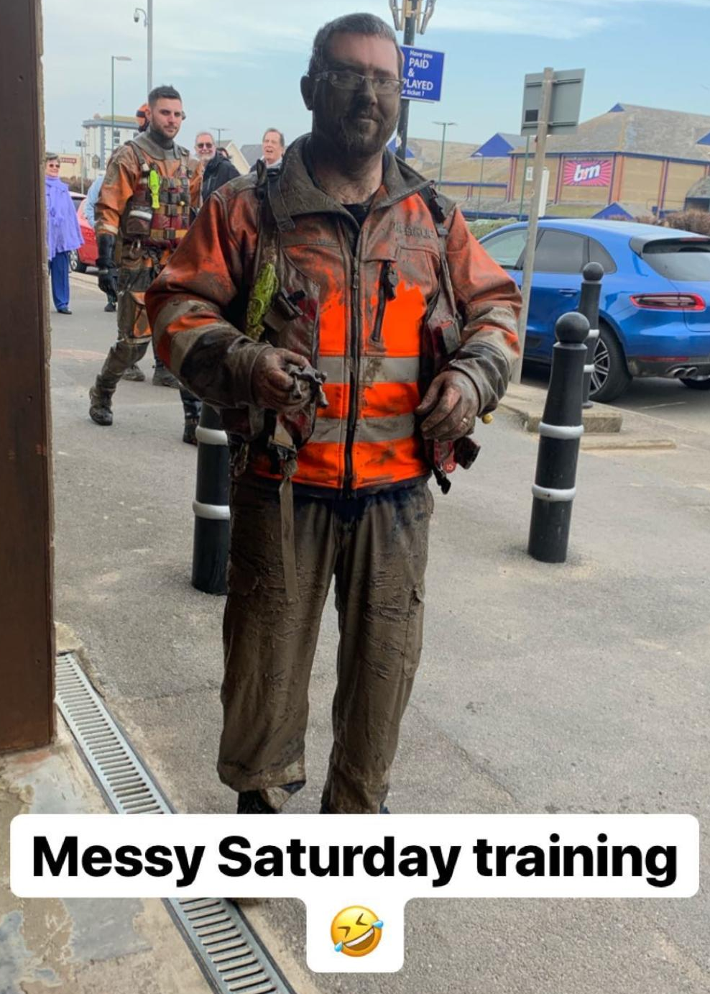
15 MINUTES IN BREAK OUT ROOMS
In your groups discuss the following:
How did the video clip make you feel?
What do you think was going through Toby’s mind when he fought to reach the top of the high wall?
How would you describe Toby’s resilience?

Slide 13
DISCUSSION TIME
1) CONSIDER your opinions discussed in your groups and share..
What did you talk about?
2) If you do not wish to speak, can you share your points in the team’s chat bar?

Slide 14
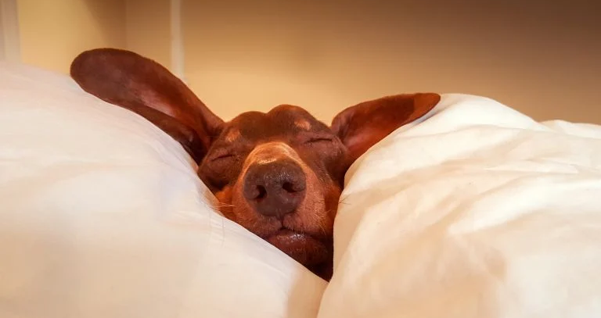
Ways to build RESILIENCE
Task (5 min)
Consider how could you use the techniques to your advantage to build your resilience?
What does each picture represent?
Exercise Sleep and rest Talking to someone about challenges
Doing things that make you happy Focusing on your strengths Healthy eating/regular meals

Slide 15
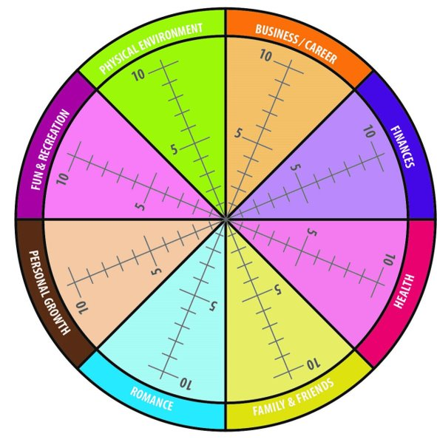
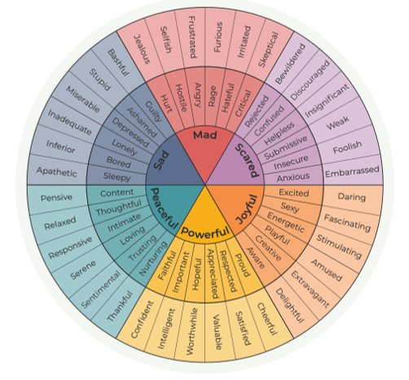
TO SUPPORT YOUR RESILIENCE.
IDENTIFY A CHANGE YOU COULD MAKE WITHIN THE NEXT 24 HOURS TO DEVELOP YOUR RESILIENCE?
SELECT AN AREA IN YOUR LIFE WHICH YOU FEEL WOULD HELP YOU BUILD YOUR RESILIENCE?
SCALE yourself out of 10 of you feel at the moment.
SET yourself a goal within the next 24 hours.
https://www.marcohealthtech.com/emotion-wheel-app/

Slide 16
Managing stress in CV 19 - here
Extra Resources
Benefits of Failure - Speech by J. K. Rowling, Author of Harry Potter

Slide 17
THANK YOU
For further information on this topic including a webinar led by specialist wellbeing practitioners, please visit the Talking Health series of the Let’s Chat website.
Let’s Chat Talking Health webinar series

