Slide 1
LET’S CHAT TUTORIAL SERIES
LONELINESS (Level 1 Post-16 learners)

Slide 2
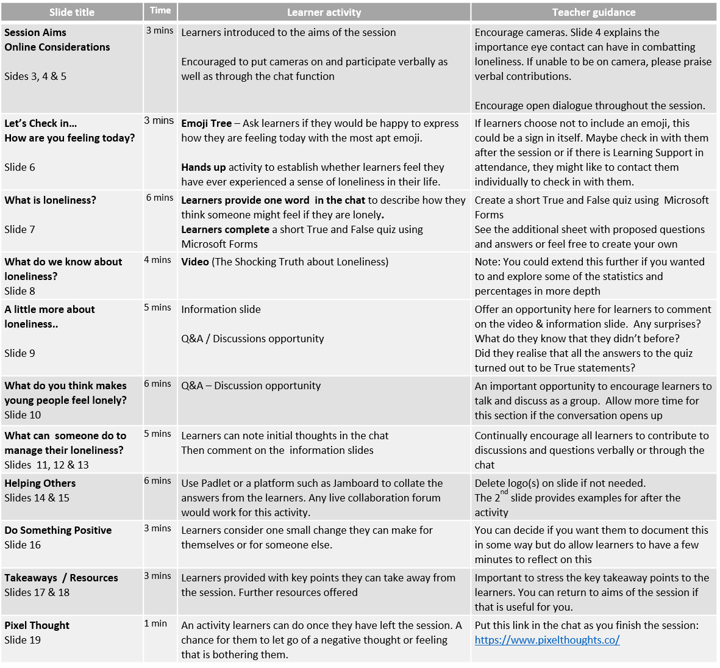
Tutor
Notes:
This session can be adapted to suit your learners’ needs. Feel free to add, change or omit activities or resources as you see fit.
The importance of this session is to get learners talking about loneliness. Allow this to unfold if it does, do not worry if this takes time over other activities.
Some activities may involve minimal preparation before the session, such as setting up a Microsoft Form or a Padlet, for example.

Slide 3
This Session
Expectations:
Mutual Respect
Trust and Confidentiality
Contribution
What we will explore today:
We will look at what loneliness is
We will examine what factors might make a young person feel lonely
We will discuss ways that could help combat feelings of loneliness
We will discuss ways to support others who may be feeling lonely
We will consider positive changes that we can make for ourselves or for someone else in our lives

Slide 4
Loneliness & Eye Contact
Did you know that…
Face-to face communication, especially eye contact, satisfies our need as humans to interact with others.
Eye contact allows you to communicate with another person in ways that words cannot do on their own.
Without eye contact, you could miss out on key feelings / emotions that can come from seeing another pair of eyes. Missing out on this can contribute to feelings of isolation and loneliness.

Slide 5
We’d love to see you!
With that in mind, we encourage you to join this session with your camera on, if you can.
Look out for these symbols along the way that provide opportunities for us to see you, hear you and read your thoughts in the chat.

Slide 6
Let’s Check In… How are you feeling today?
Let’s Check In… How are you feeling today?
Choose the emoji which best represents how you feel today
Please place it in the chat.
If you feel comfortable, we would love to hear why you have chosen that particular emoji.
Next:
Use the ‘Hands up’ function if you believe you have experienced a feeling of loneliness in your life.
Now pop your hands down
Thank you so much for sharing

Slide 7
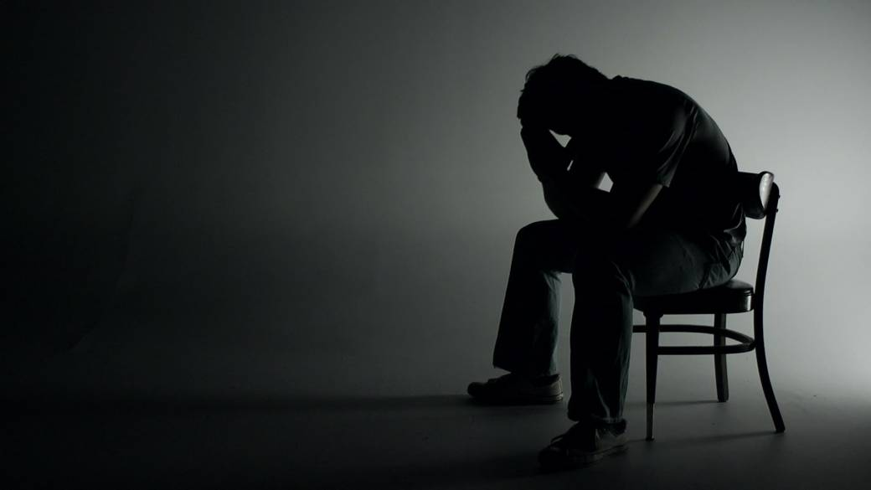
What is Loneliness?
Using the Chat Function:
Provide one word you think could describe how someone might be feeling if they are lonely.
Then click on the link in the chat to complete a quick True and False quiz

Slide 8
What do we need to know about loneliness?

Slide 9
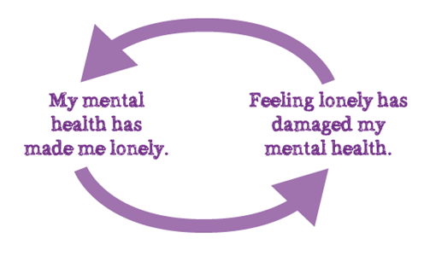
A little more about loneliness?
We all feel lonely from time to time.
You may choose to be alone and live happily without much contact with other people
Or you may have lots of social contact, or be in a relationship or part of a family, and still feel lonely – especially if you don't feel understood
Feeling lonely isn't in itself a mental health problem, but the two are strongly linked.
Feeling lonely can also have a negative impact on your mental health,
(Mind, 2021)

Slide 10
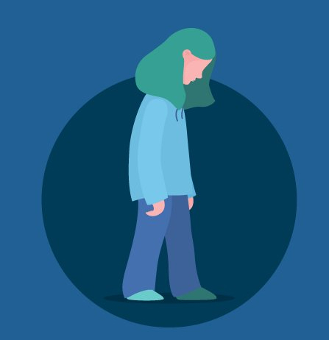
What do you think might make young people feel lonely?
Let’s Discuss Together…

Slide 11
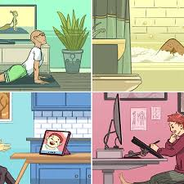
Do you have any thoughts or tips on how a person could manage their loneliness?

Slide 12
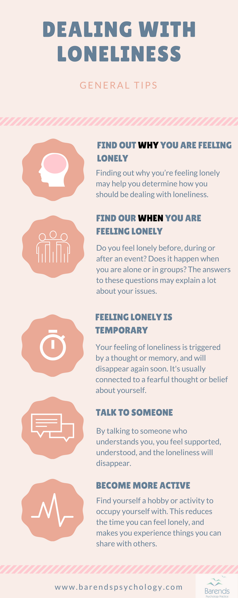

Slide 13
Apps that can help someone who is feeling lonely
TalkLife is a peer support platform and is designed to be a safe space. At TalkLife you can find someone to talk to about the struggles you share.
The app works like a directory for local groups and events listings, whether you’re looking for a new football team or want to talk about arts and crafts with like-minded individuals.
This app is built around cognitive behavioural therapy games to boost your mood and wellbeing. The app has been developed by scientists to help you take control of any negative feelings and give you the confidence to meet others.
A personal trainer for your mind, the app uses AI to help you understand your emotions. You can track your moods and keep a feelings diary

Slide 14
Helping Others with Loneliness
How might you know if someone else is feeling lonely?
What could you do to support them?

Slide 15
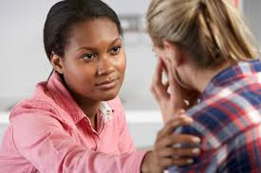
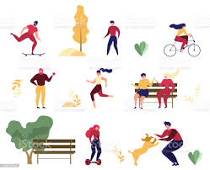
6 Ways to Cheer Up That Lonely Someone
Do Something Small
Listen
Do Something They Love
Get To Know Them Better
Be Optimistic
Help Set Goals

Slide 16
Do Something Positive for Yourself or for Someone Else
Consider what you can do for yourself to support your well-being or help you if you are feeling lonely.
If you know someone that you suspect may be feeling lonely, think of one thing you could do to support them .

Slide 17
Takeaways & Toolkit
Loneliness is universal. We all feel lonely at times
Other people won’t necessarily fill you up
Only you can fill your inner life
When you are lonely remind yourself that this feeling, if allowed, will change.
Try not to be frightened of loneliness – try to be curious
Don’t do but be
Remember we need to feel lonely to become an individual.
When you feel the thud of loneliness, remember it happens to all humans.
We don’t feel lonely because we are bad or doing it wrong
Find something that brings you peace, like music, nature, a book
In the lonely times we get to know ourselves better and that will make us less lonely

Slide 18
Additional Information / Resources:
BBC Radio 4 - All in the Mind - Take part in the BBC Loneliness Experiment
https://www.mind.org.uk/information-support/tips-for-everyday-living/loneliness/tips-to-manage-loneliness/
https://letstalkloneliness.co.uk/advice/
https://www.supportline.org.uk/problems/loneliness/

Slide 19
https://www.pixelthoughts.co/

Slide 20
THANK YOU
For further information on this topic including a webinar led by specialist wellbeing practitioners, please visit the Talking Health series on the Let’s Chat website.
Let’s Chat Talking Health webinar series

